Slide 1

ECS 351L and 851L: Geospatial Data Science
Lecture 3: Network data analysis
Email: jonathan.ryan@duke.edu
Office: 3101 Grainger Hall
Office hours: Mondays and Wednesdays 15:00-16:00

Slide 2
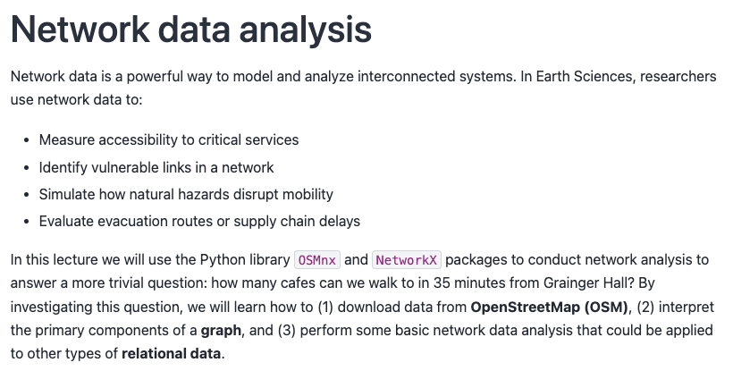

Slide 3
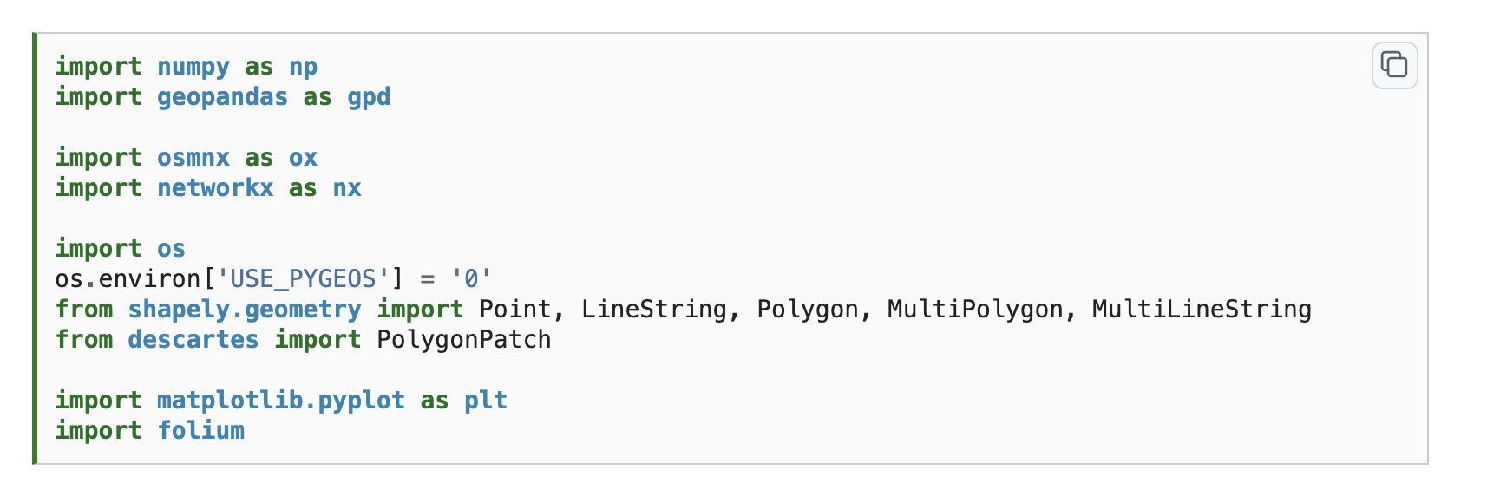

Slide 4
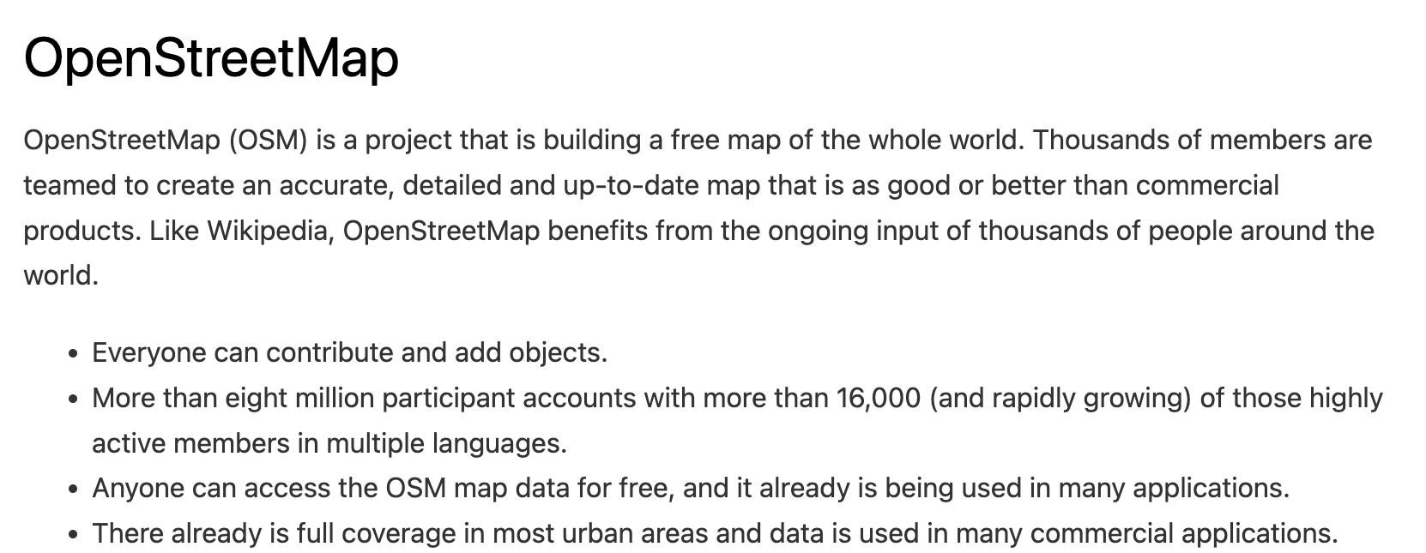
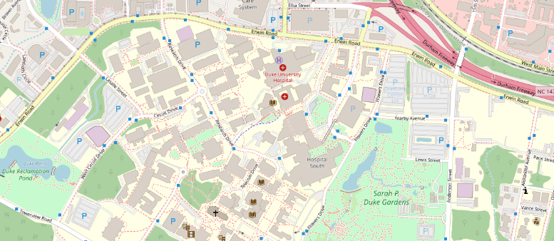
Notes:
OSM is an extremely rich source of geospatial data. It works on the Volunteered Geographic Information principle.

Slide 5
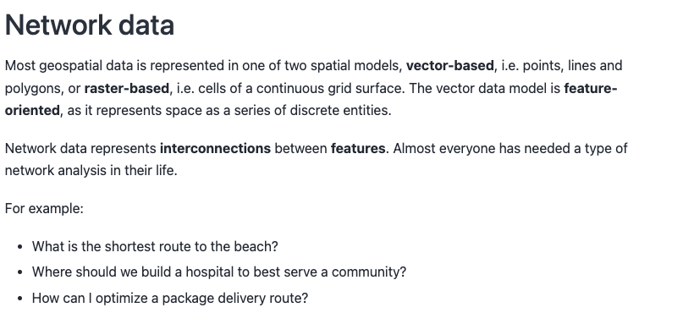
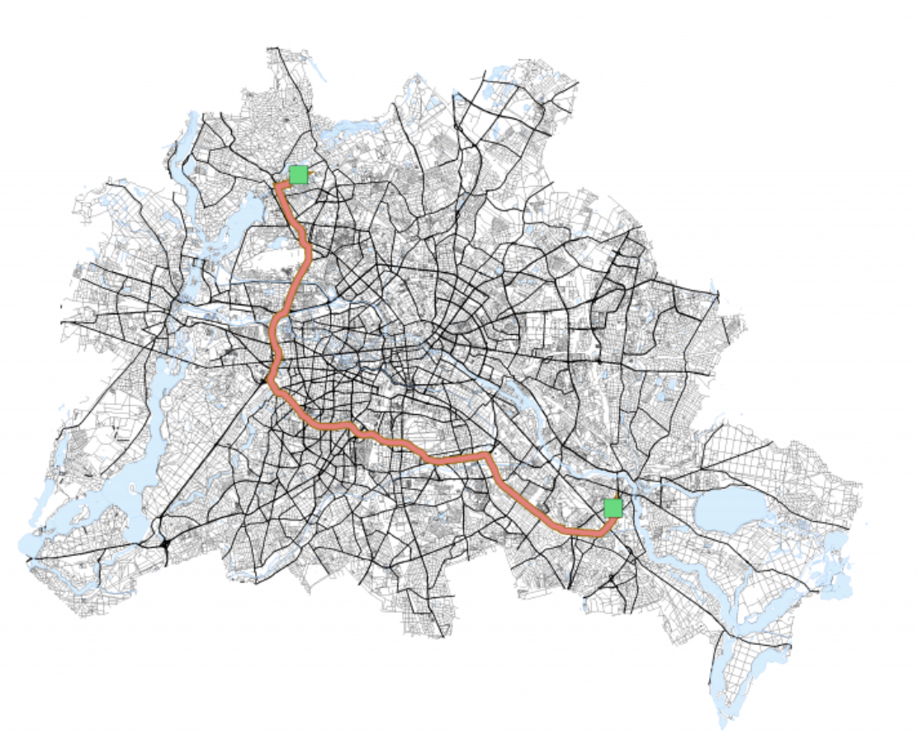

Slide 6
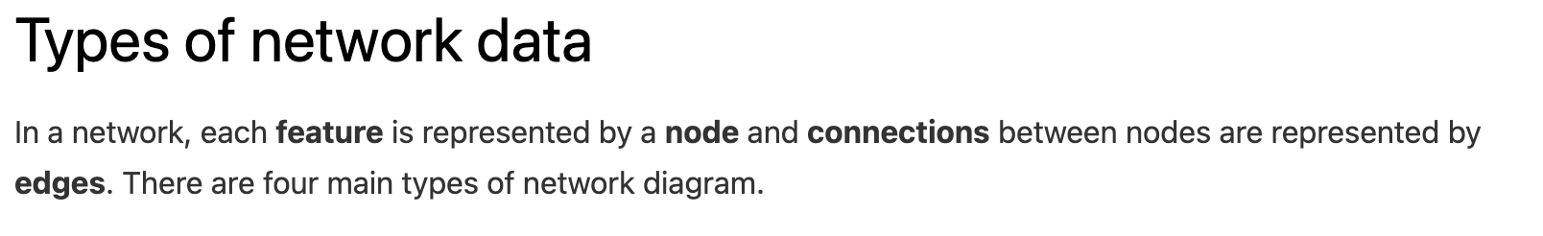
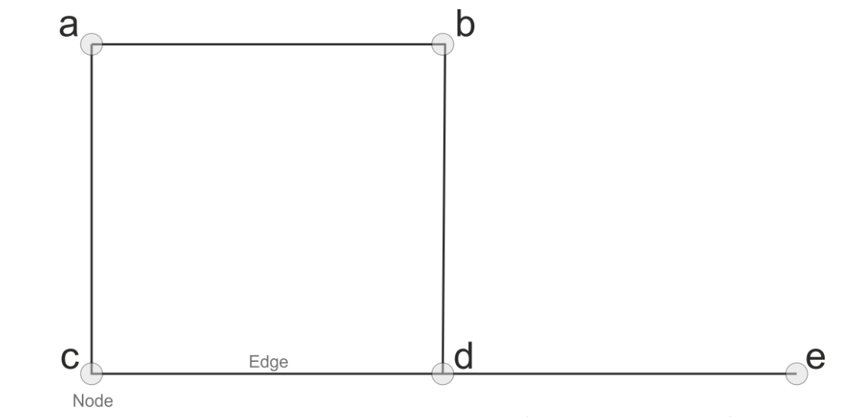

Slide 7
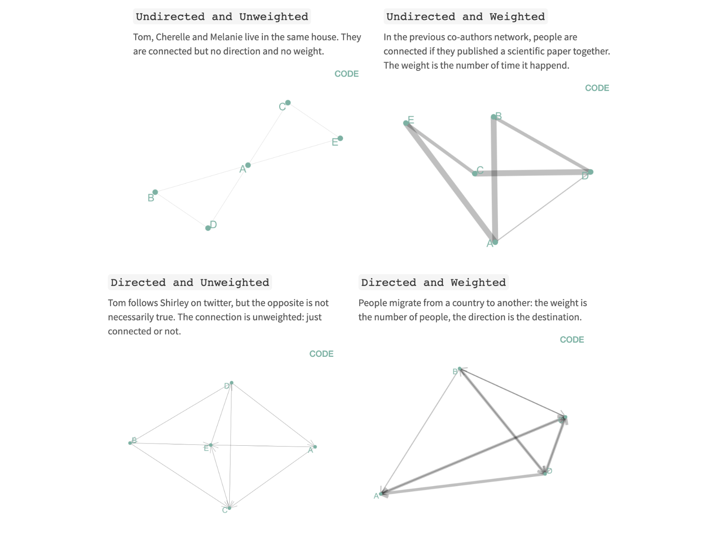
Notes:
There are four types of network

Slide 8


Slide 9
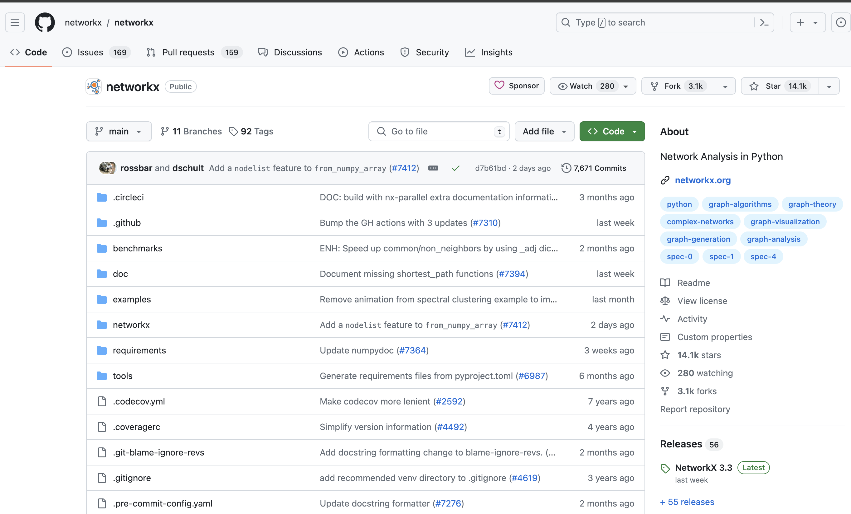

Slide 10
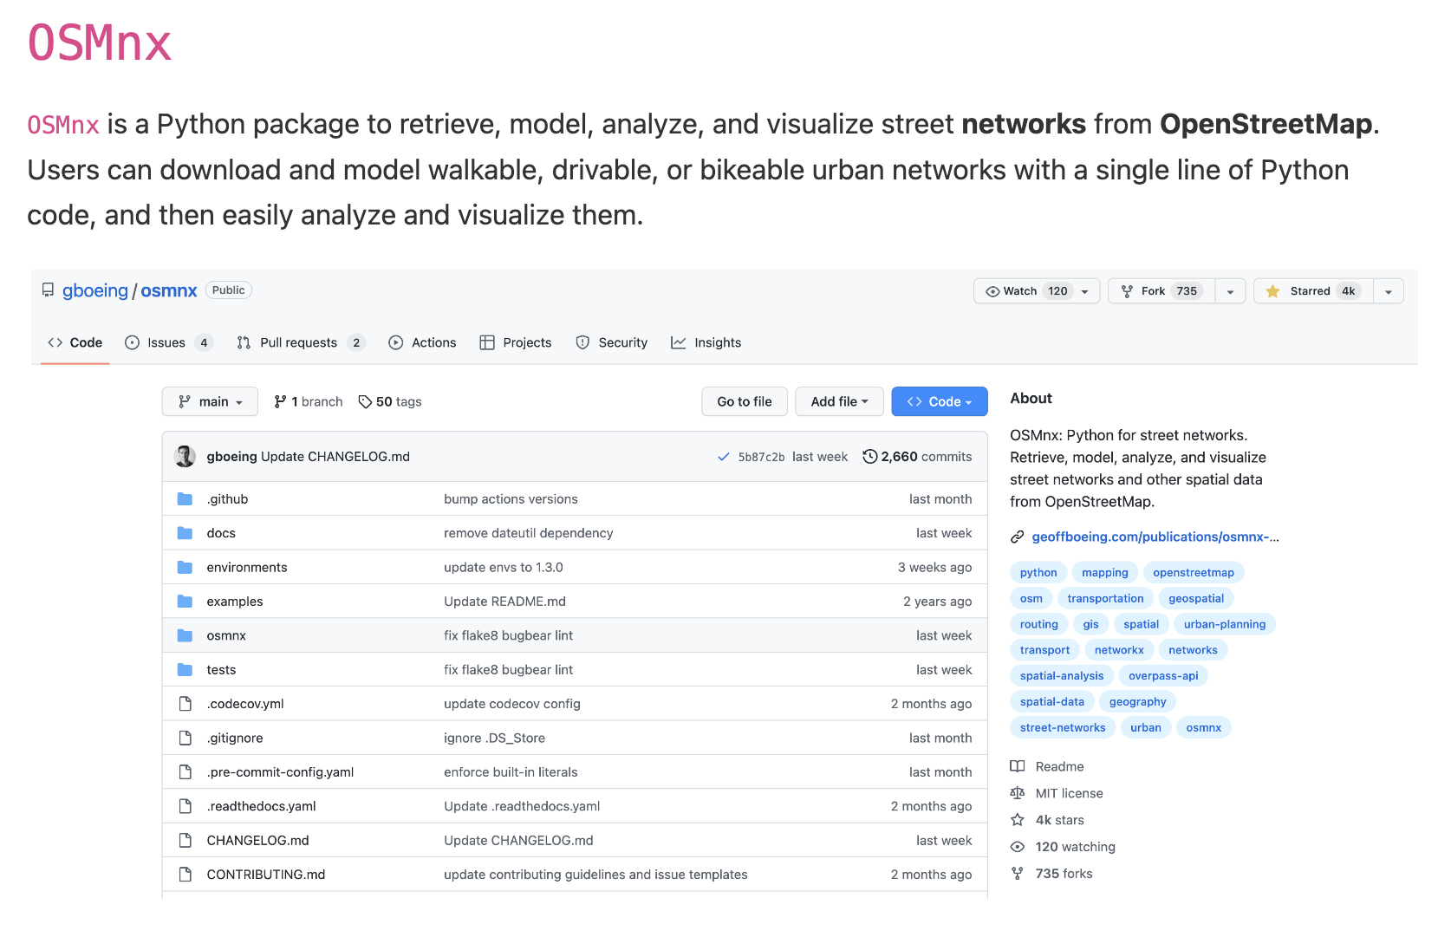

Slide 11
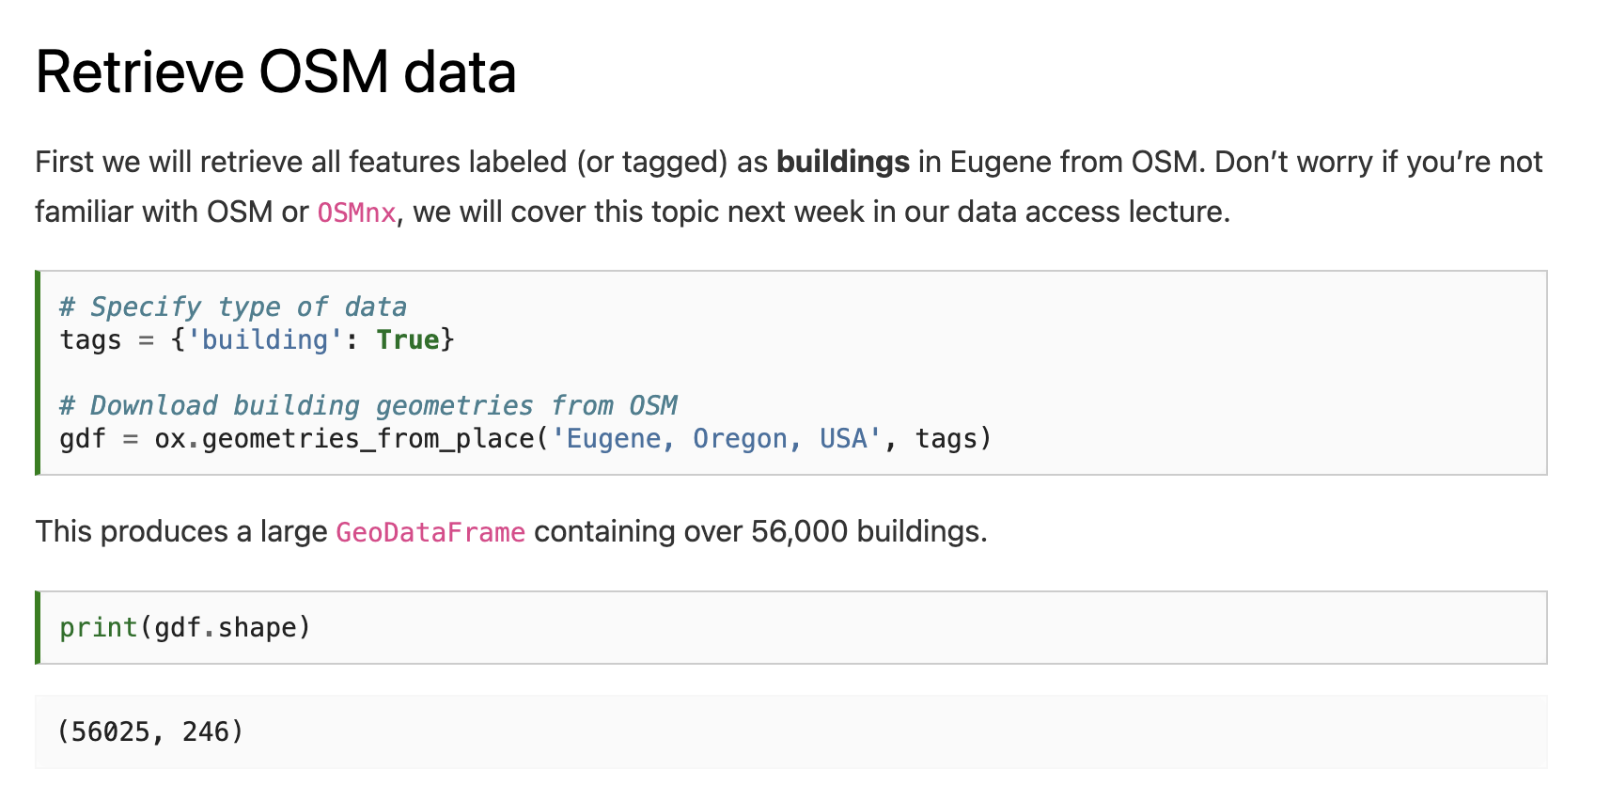
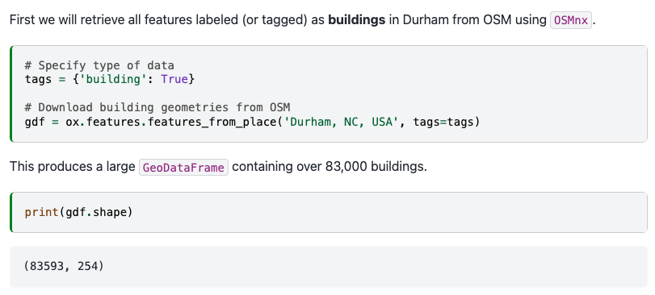

Slide 13
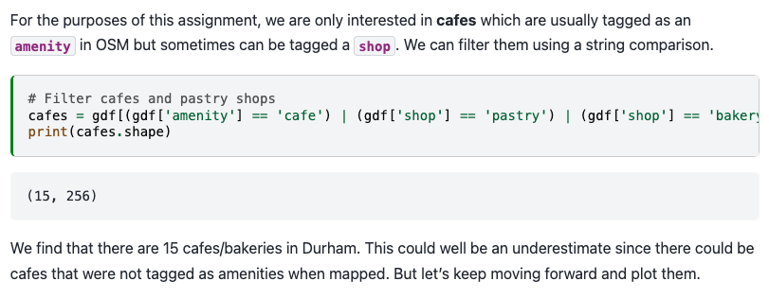

Slide 14
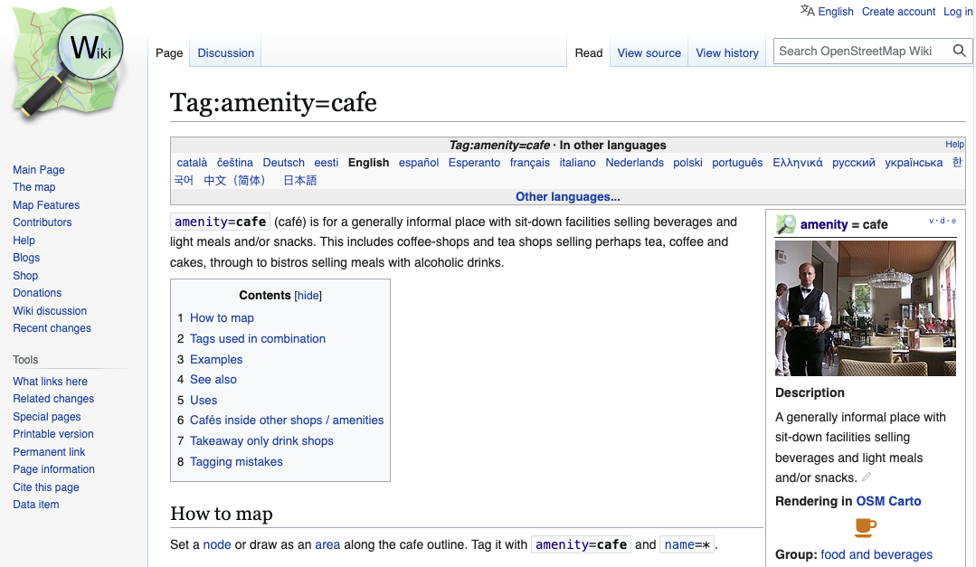

Slide 15
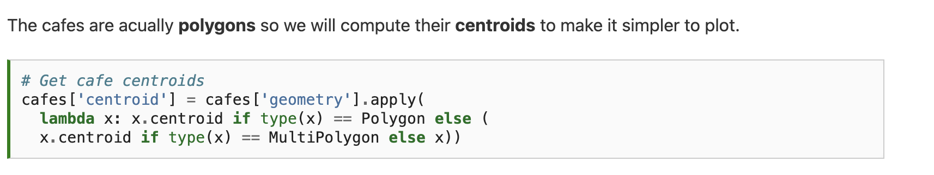

Slide 16
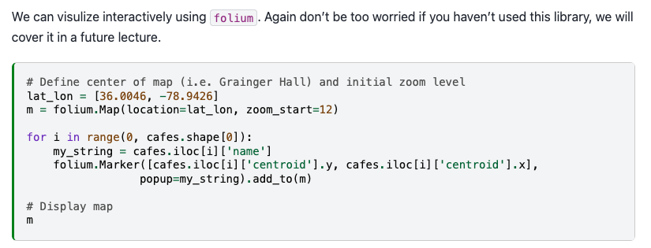
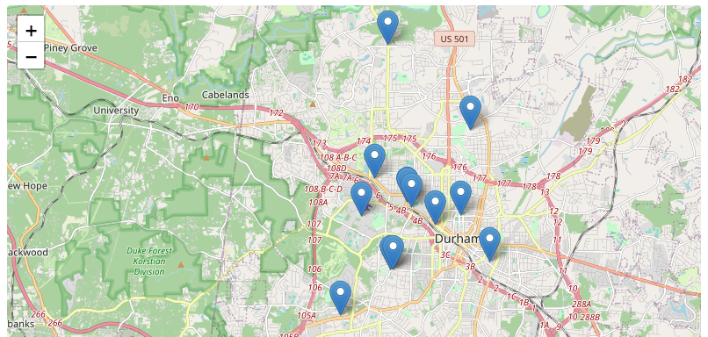

Slide 17
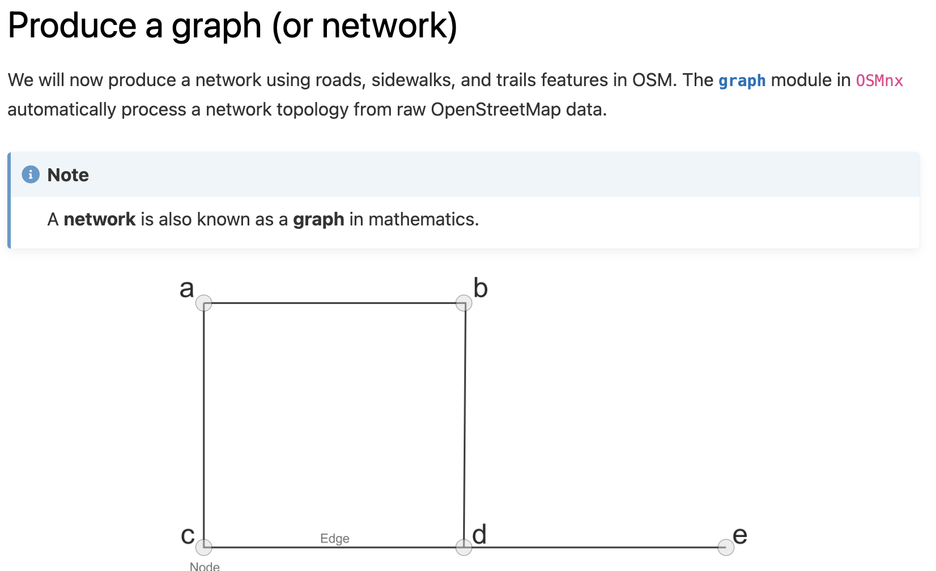

Slide 18
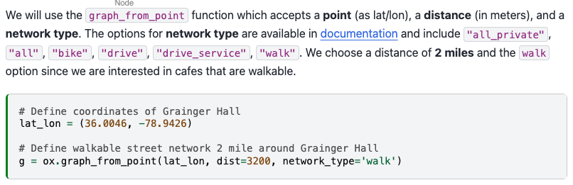

Slide 19
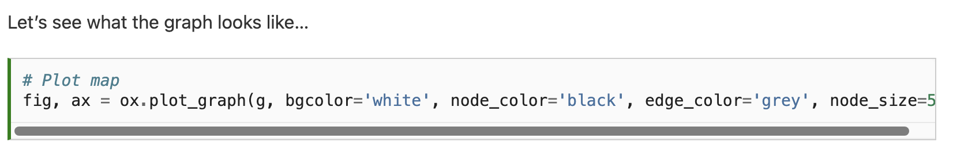
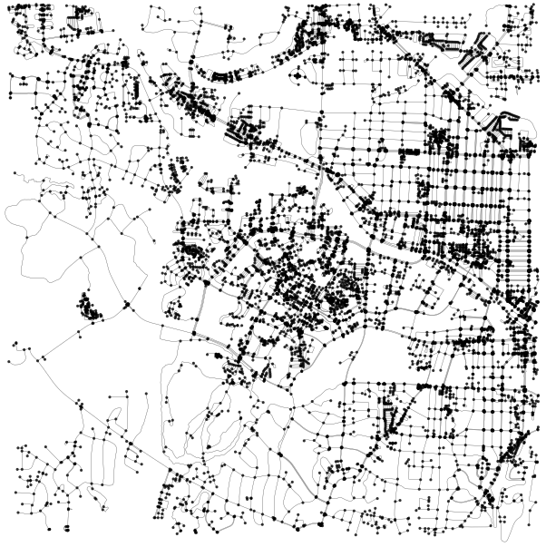

Slide 20
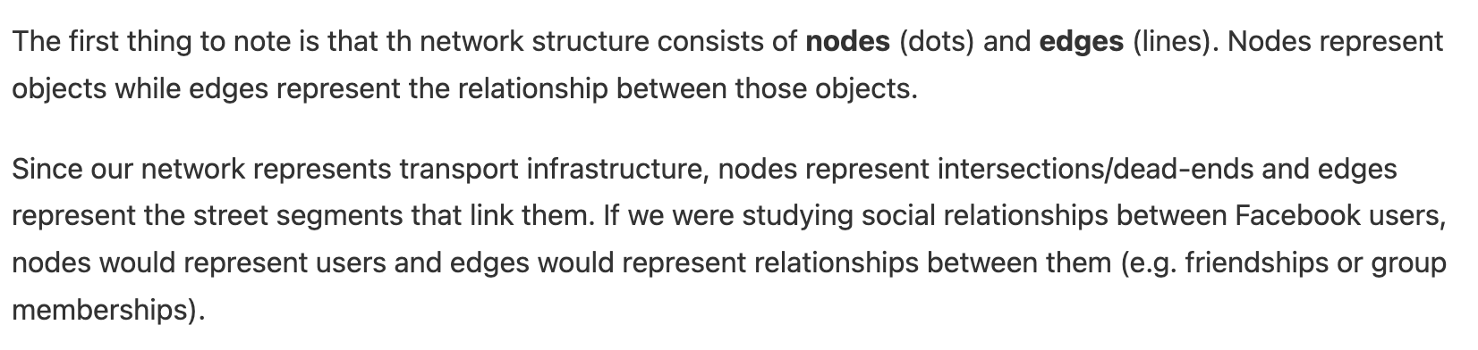

Slide 21
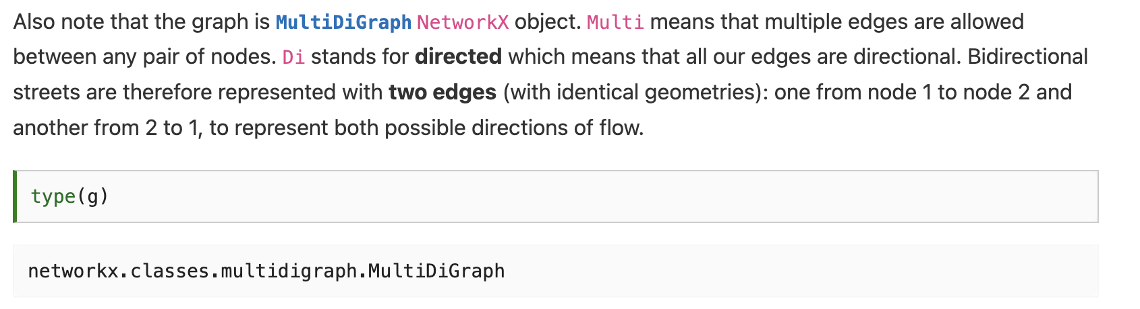

Slide 22
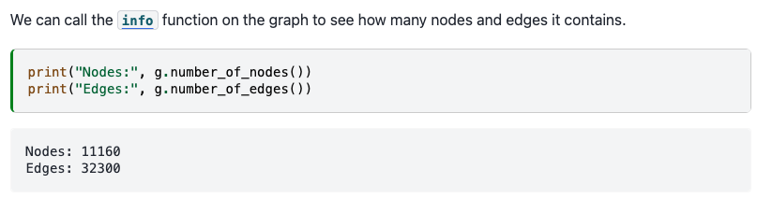

Slide 23
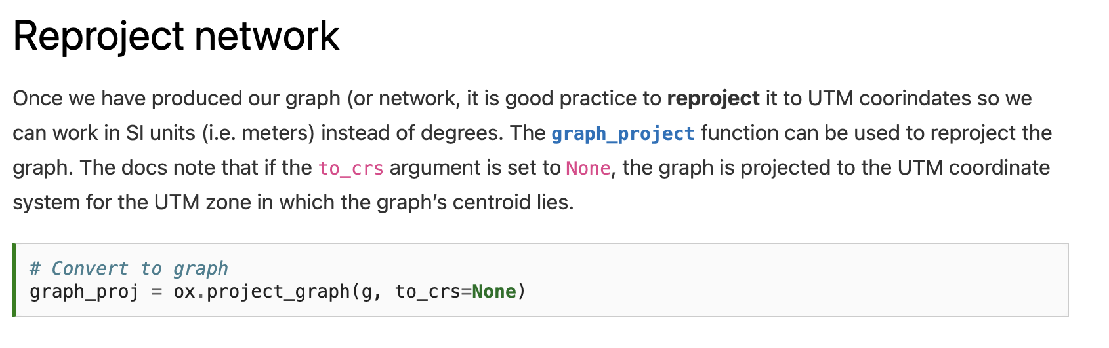

Slide 24
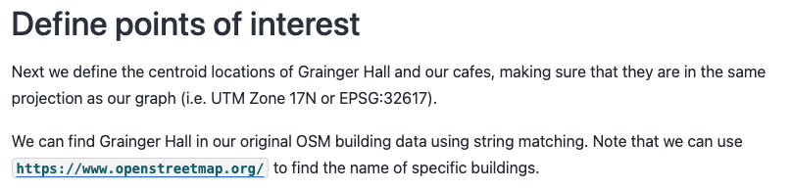
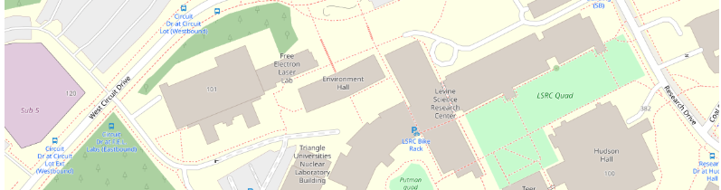

Slide 25
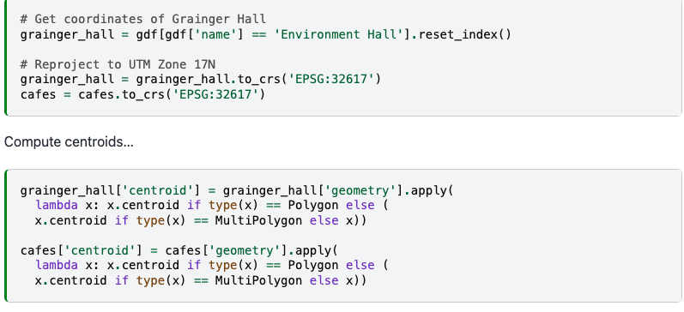

Slide 27
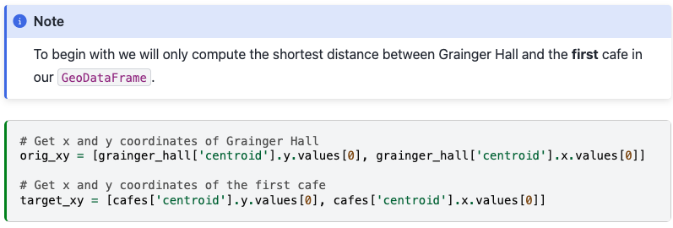

Slide 28
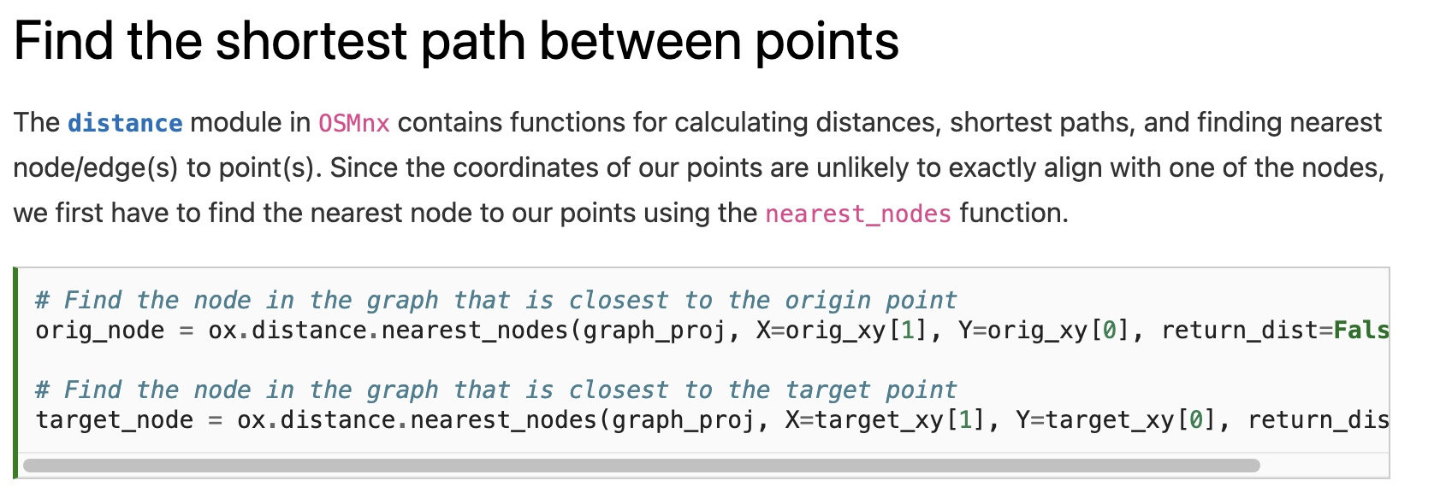

Slide 29
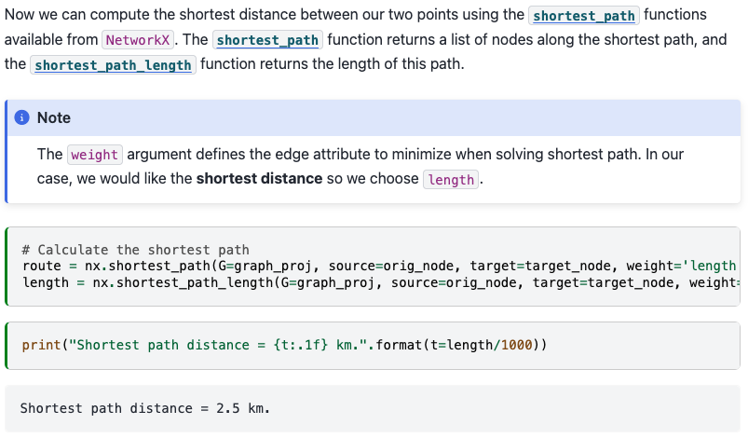

Slide 32
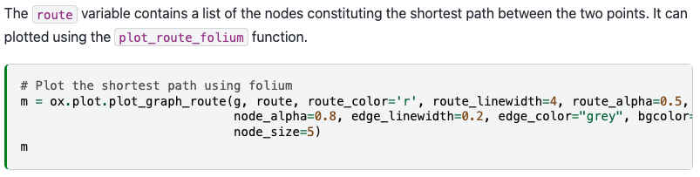
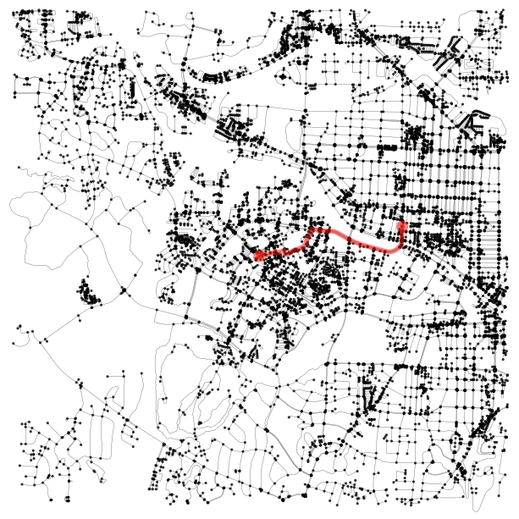

Slide 33
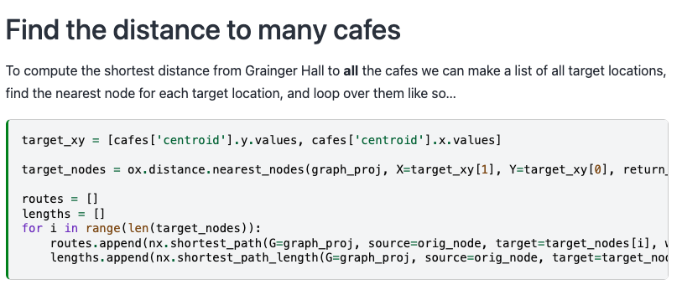

Slide 34
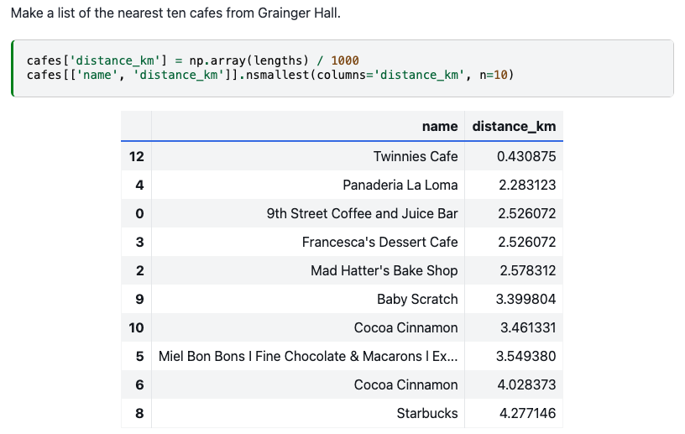

Slide 35
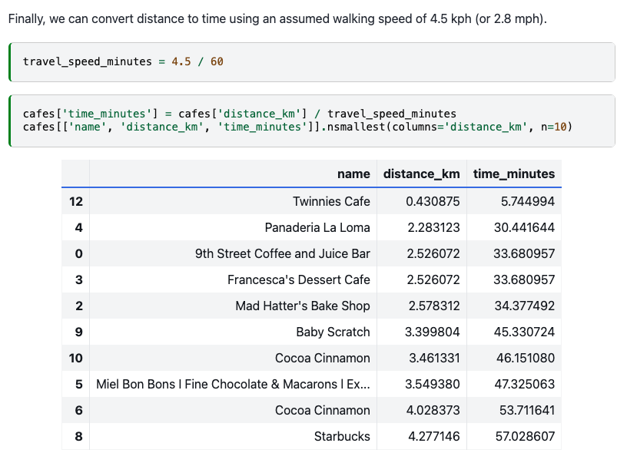

Slide 36
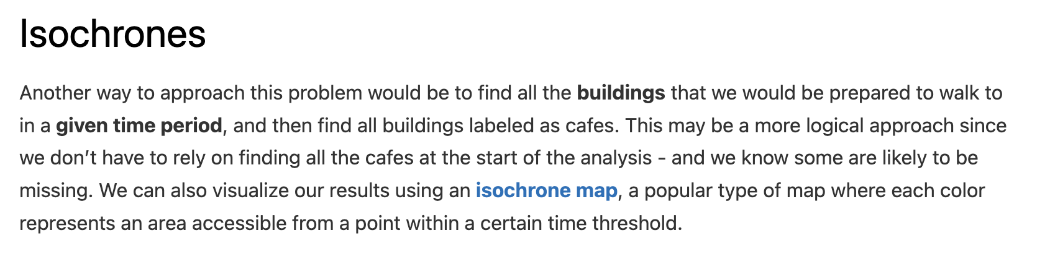

Slide 37
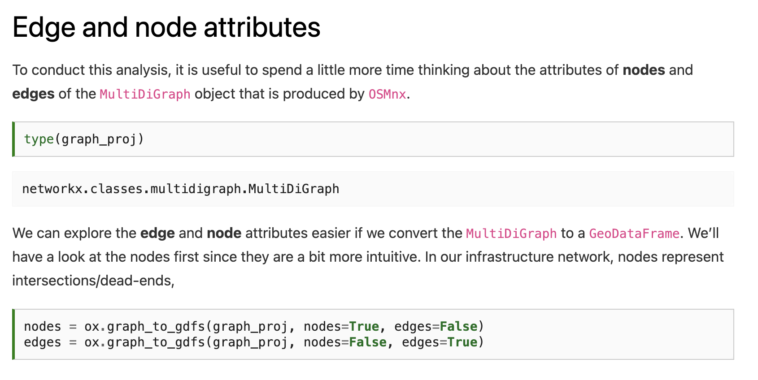

Slide 39
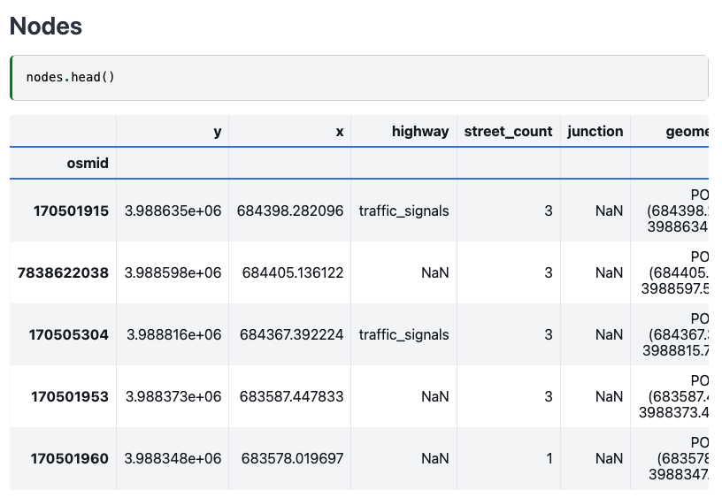
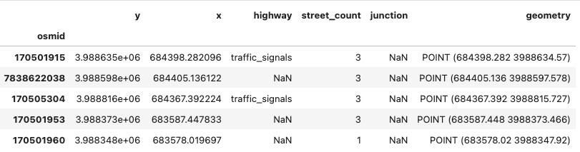

Slide 40
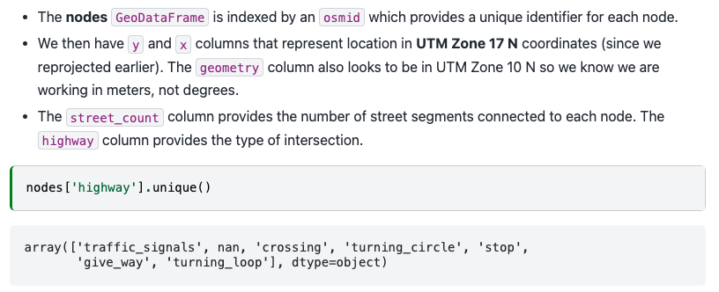

Slide 41
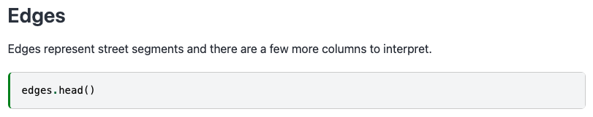
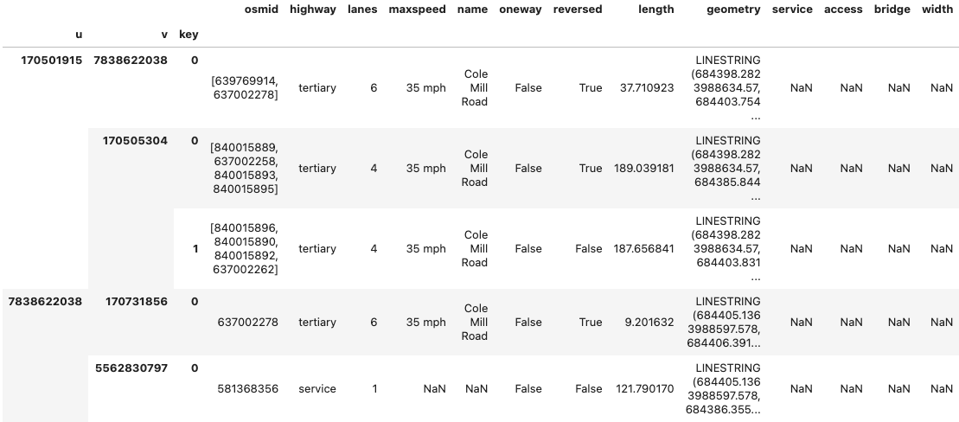

Slide 42
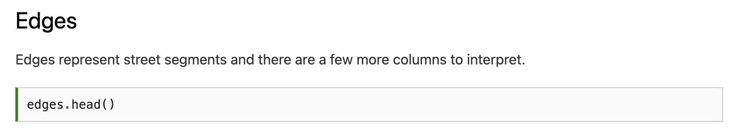
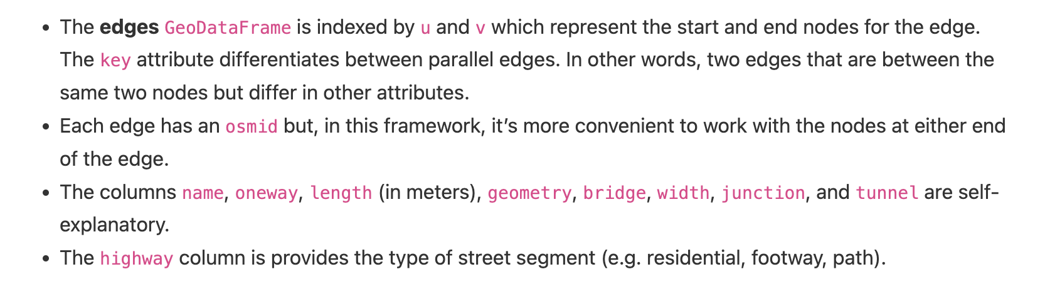

Slide 43
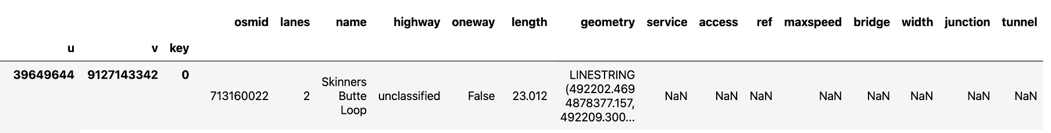
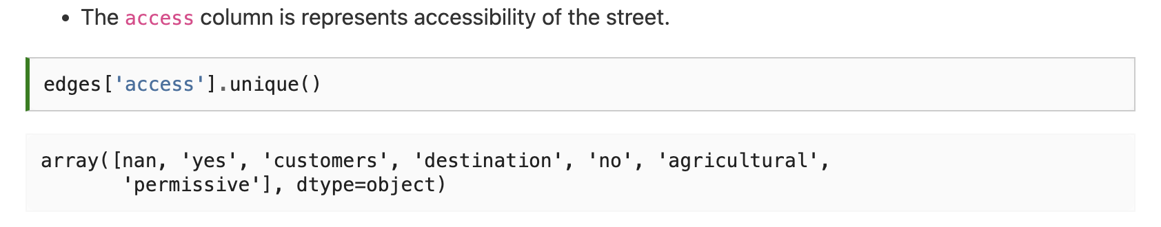

Slide 44
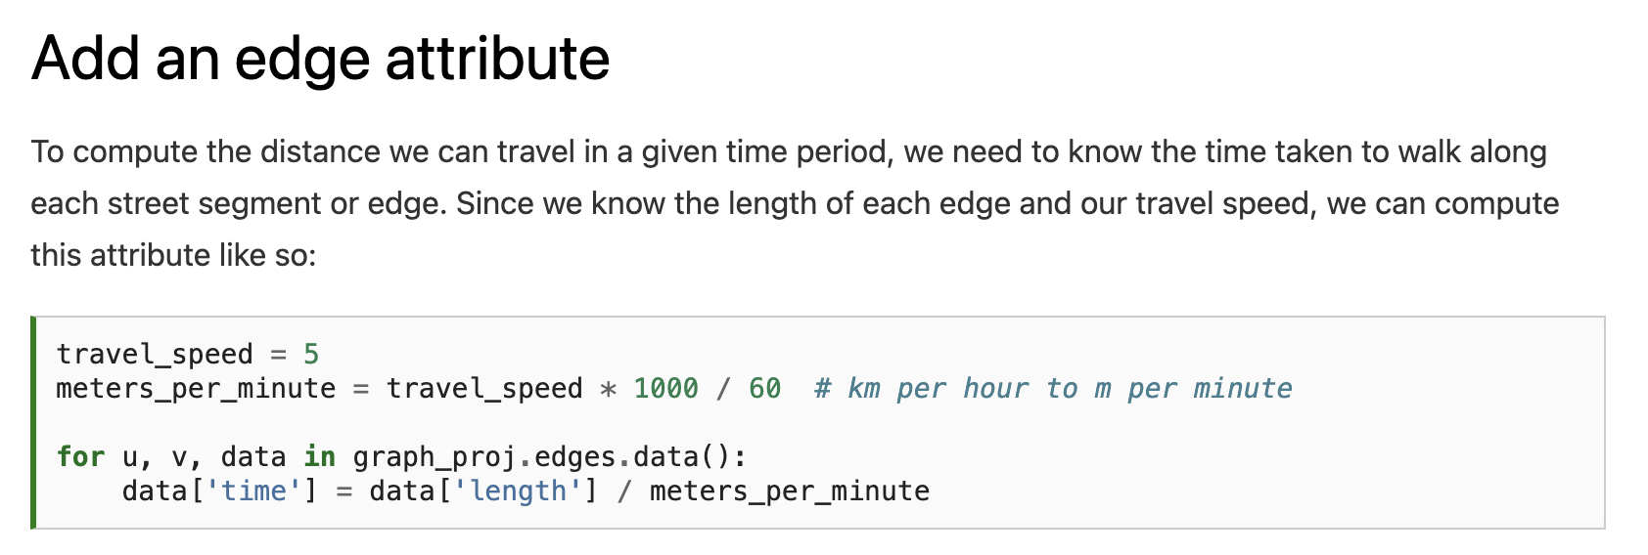

Slide 45
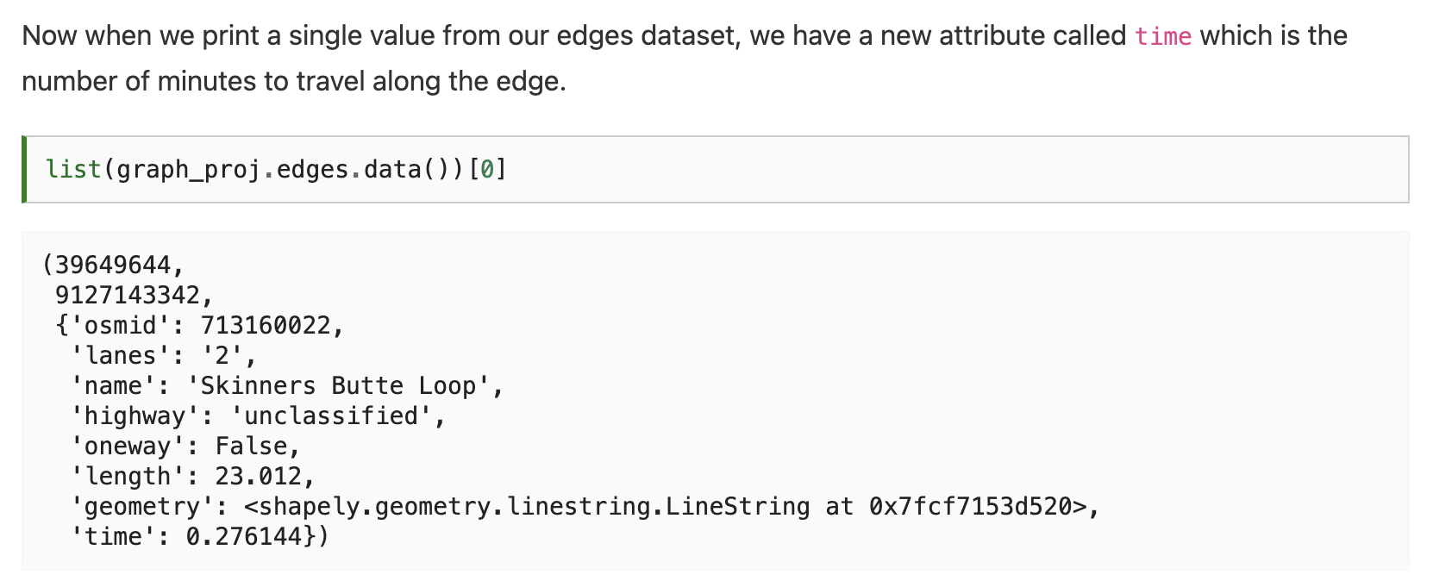


Slide 46


Slide 47



Slide 48


Slide 49


Slide 50


Notes:
This looks great but is of limited use since the buildings that we want to travel to are not necessarily associated with nodes. It would be more convenient to convert this data into polygons which we could use to intersect buildings (or points) of interest.

Slide 51

Notes:
This looks great but is of limited use since the buildings that we want to travel to are not necessarily associated with nodes. It would be more convenient to convert this data into polygons which we could use to intersect buildings (or points) of interest.

Slide 52


Notes:
This looks great but is of limited use since the buildings that we want to travel to are not necessarily associated with nodes. It would be more convenient to convert this data into polygons which we could use to intersect buildings (or points) of interest.

Slide 53

Notes:
This looks great but is of limited use since the buildings that we want to travel to are not necessarily associated with nodes. It would be more convenient to convert this data into polygons which we could use to intersect buildings (or points) of interest.

Slide 54

Next time: Vector data activity
Email: jonathan.ryan@duke.edu
Office: 3101 Grainger Hall
Office hours: Mondays and Wednesdays 15:00-16:00

